Slide 1
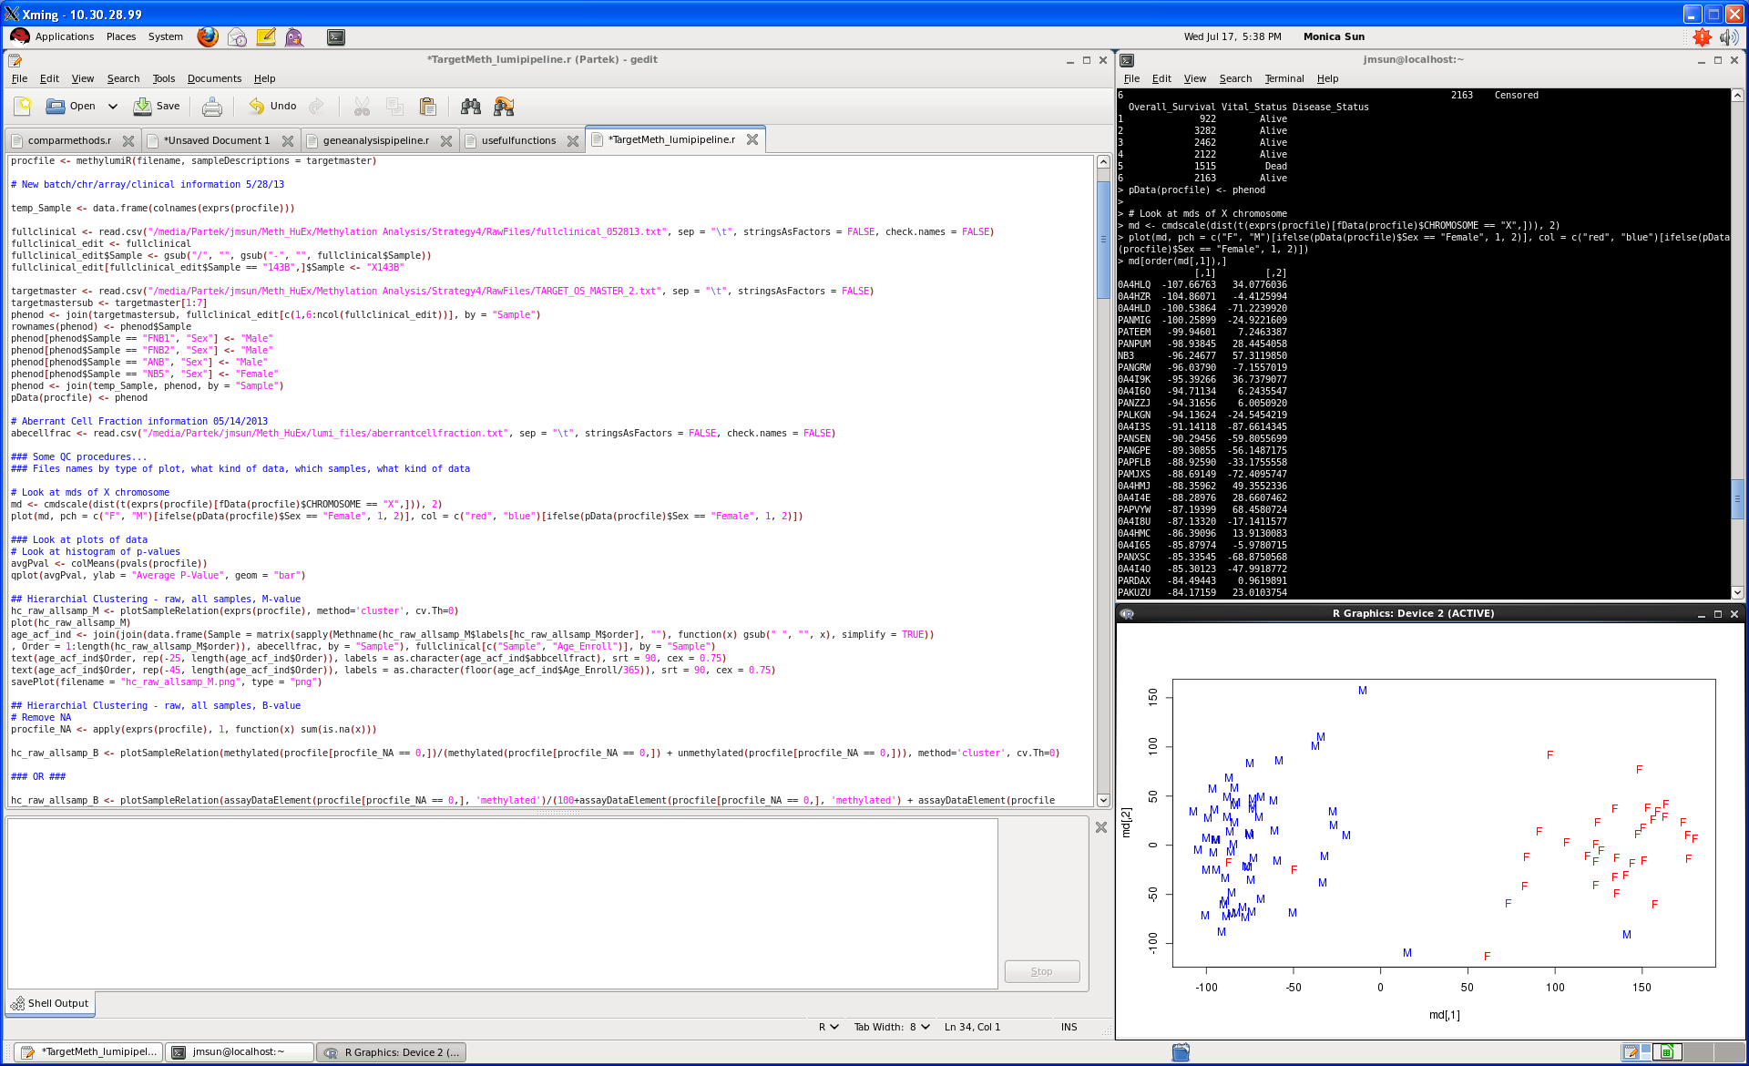
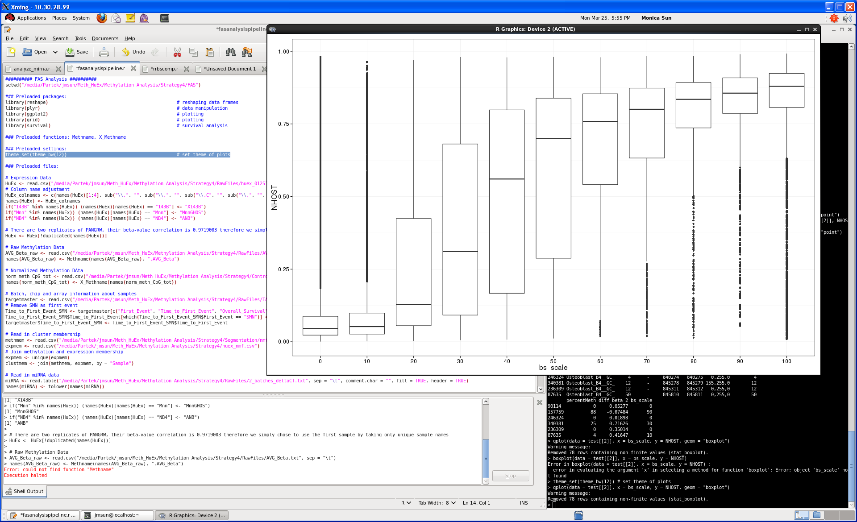
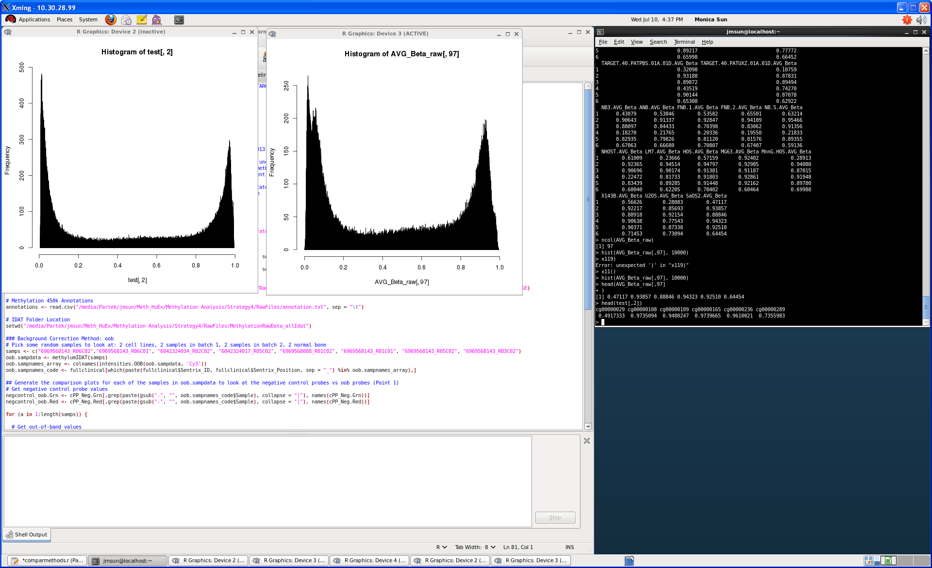
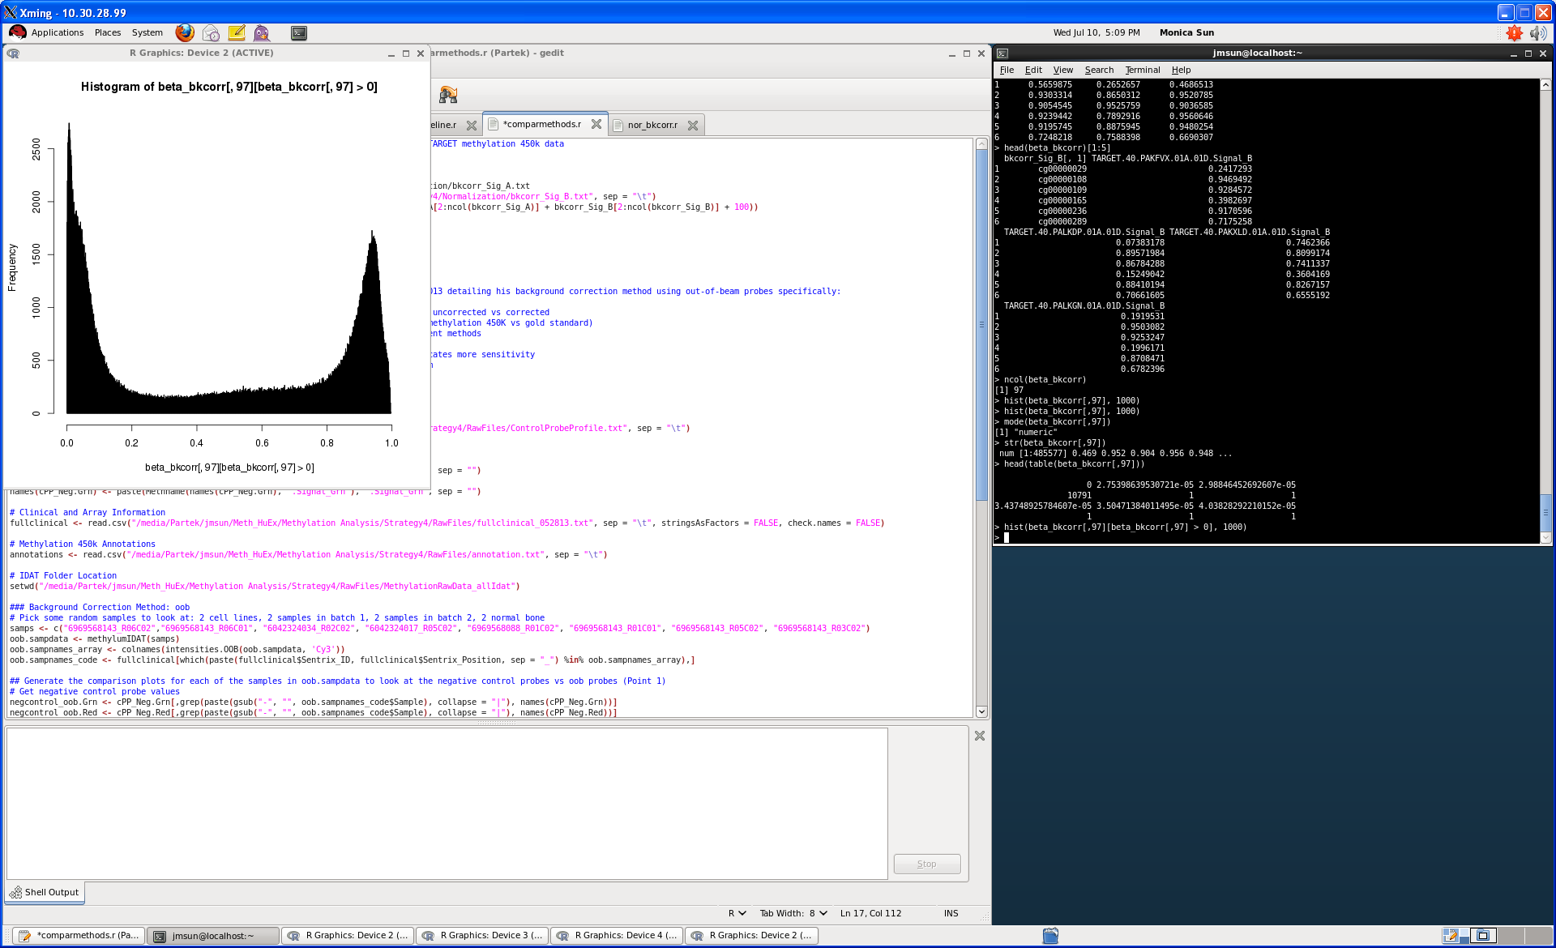
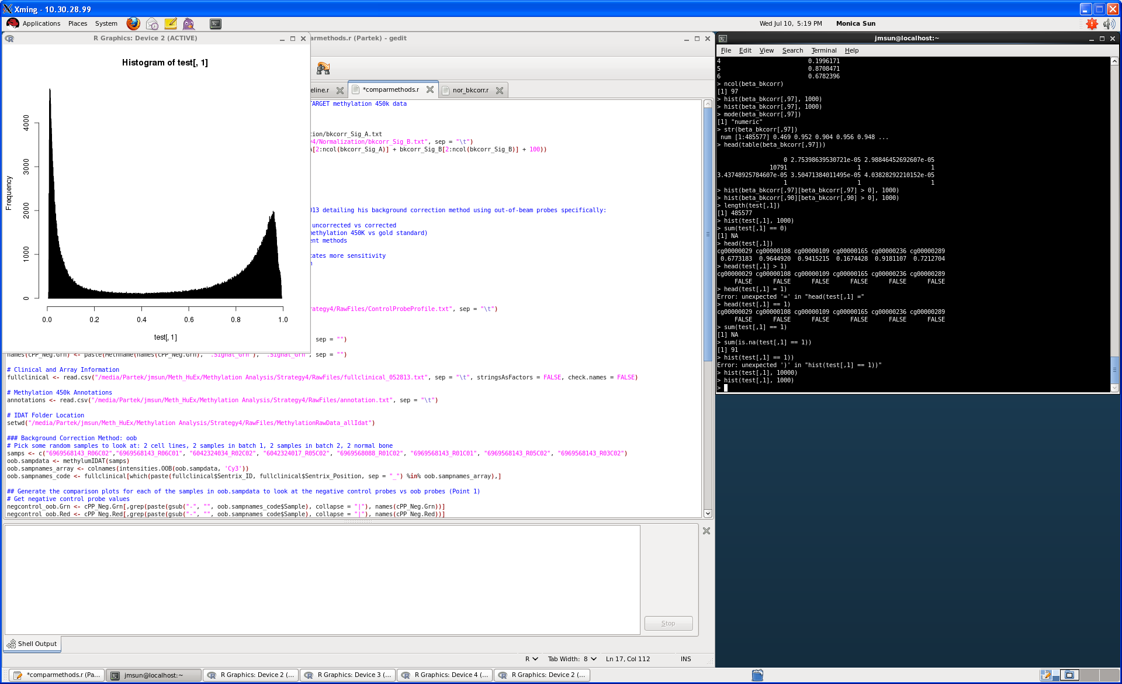
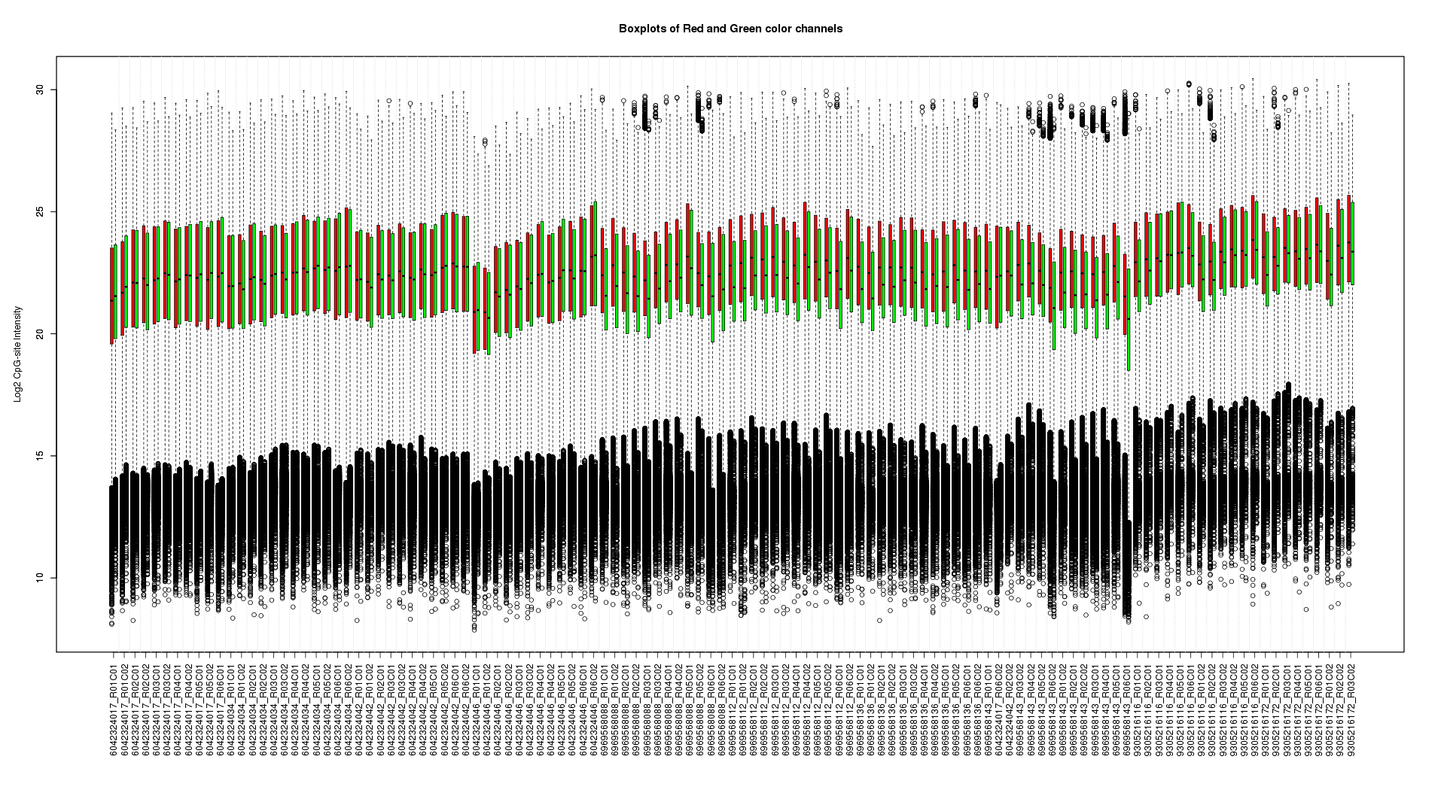
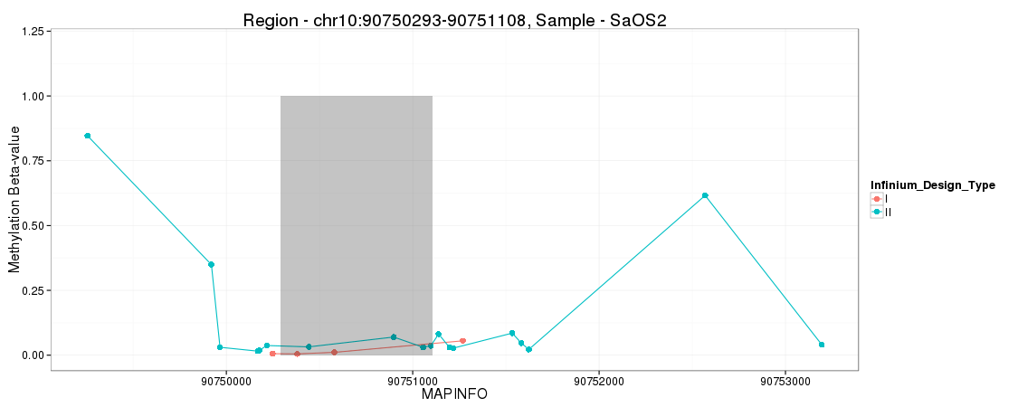
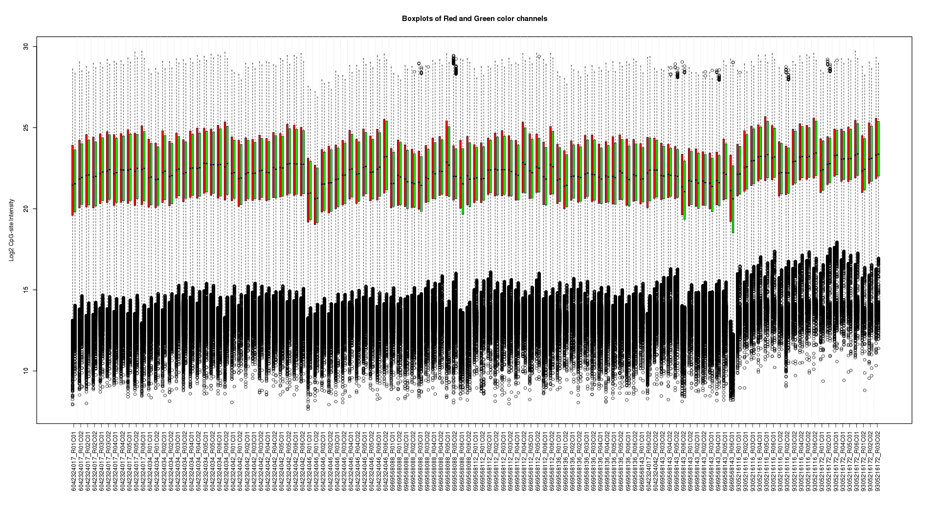
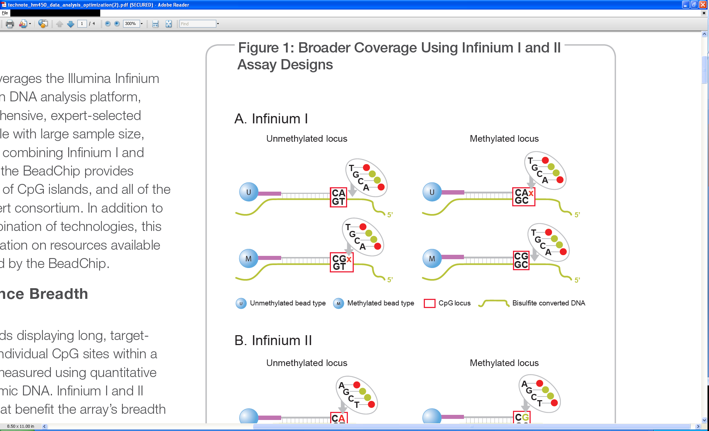
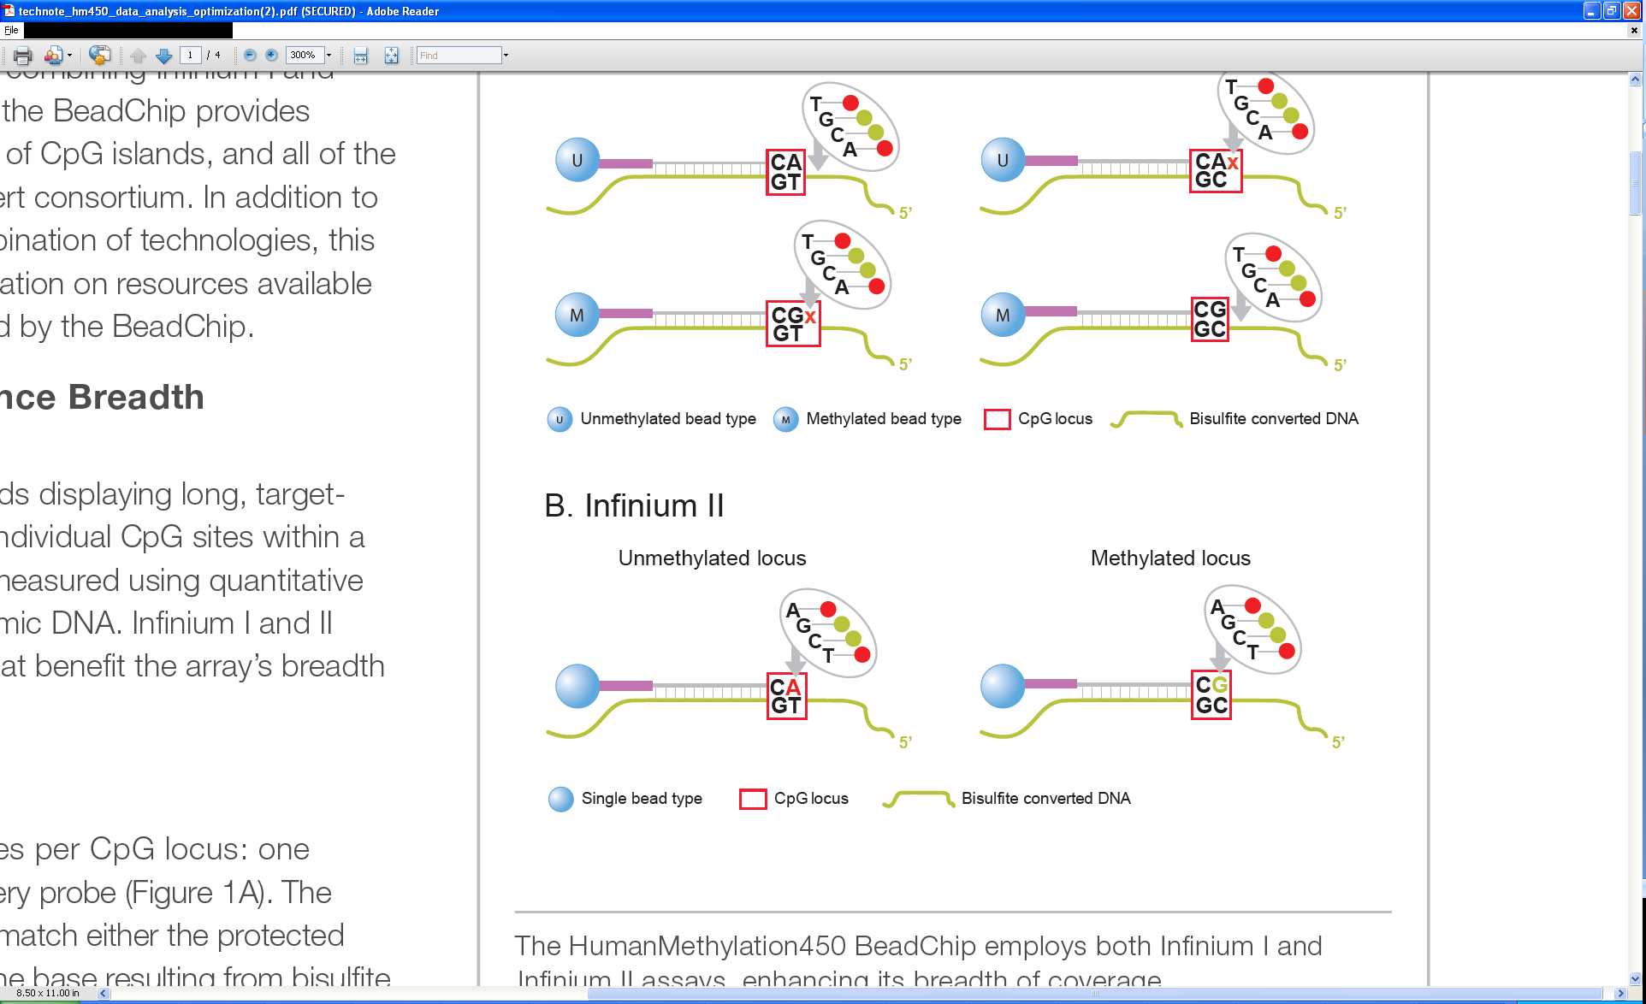
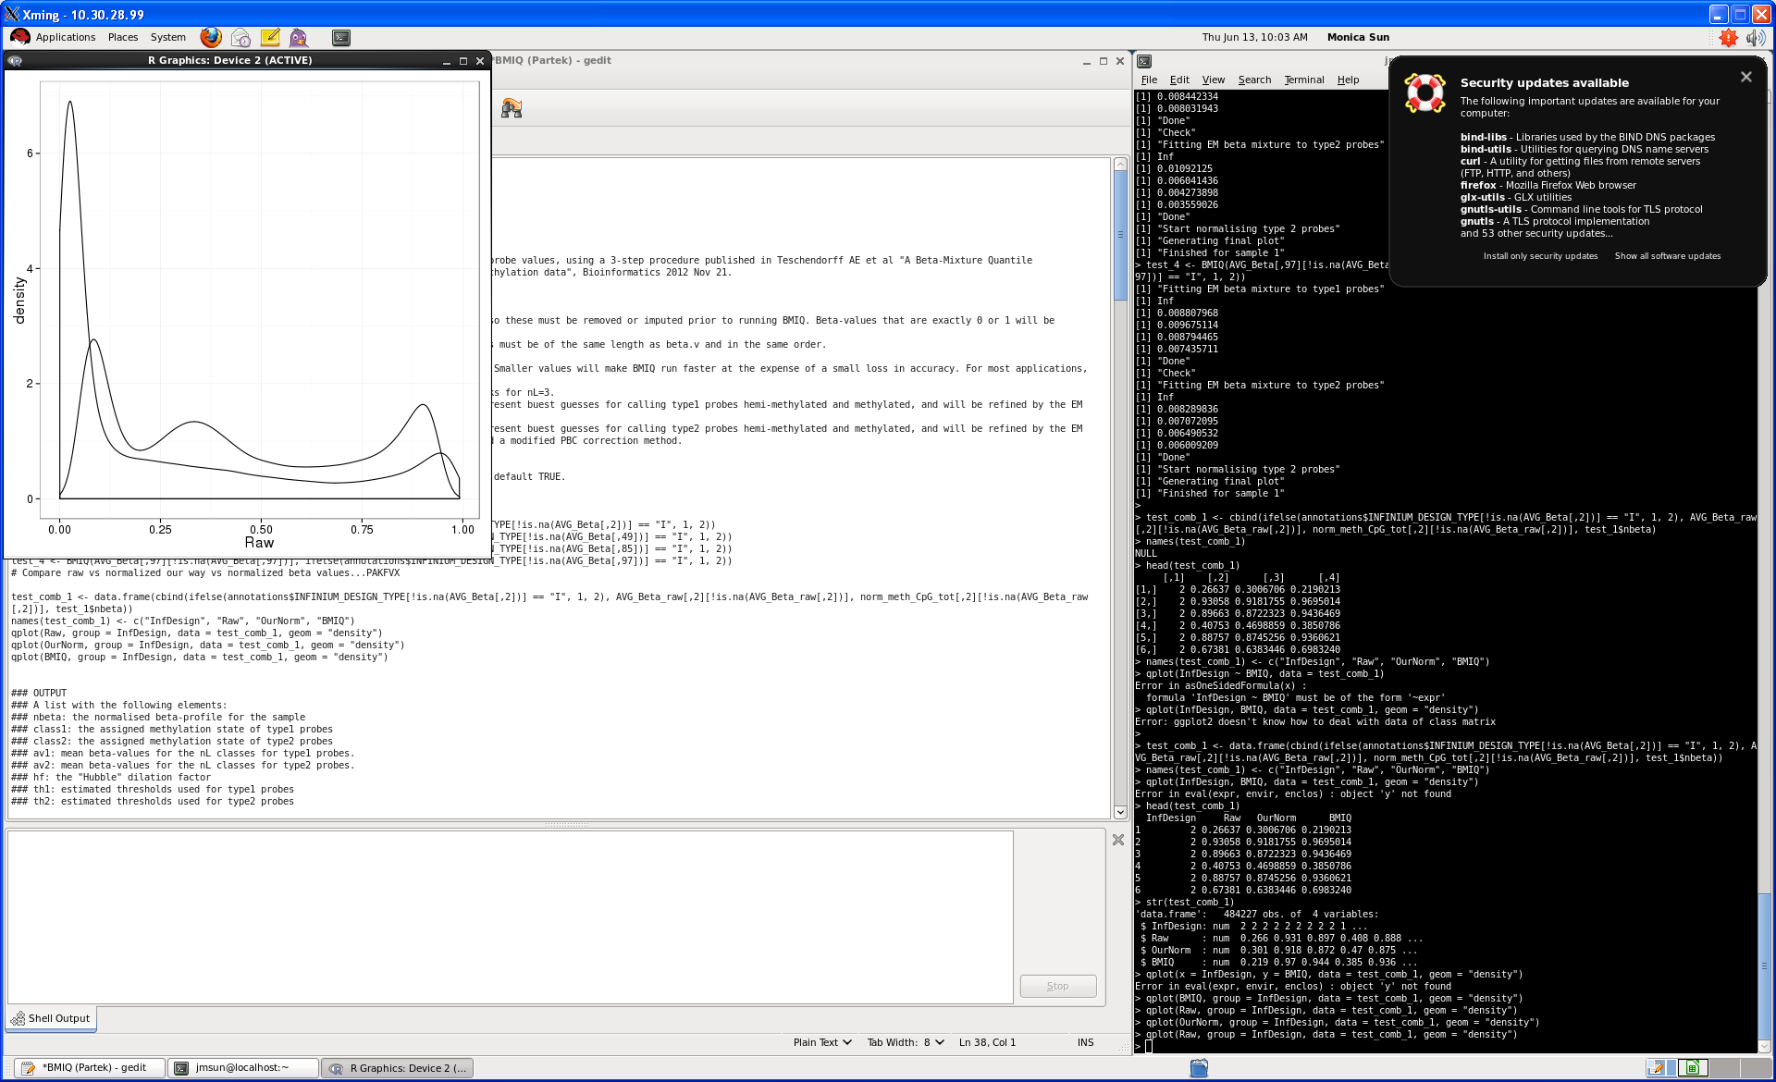




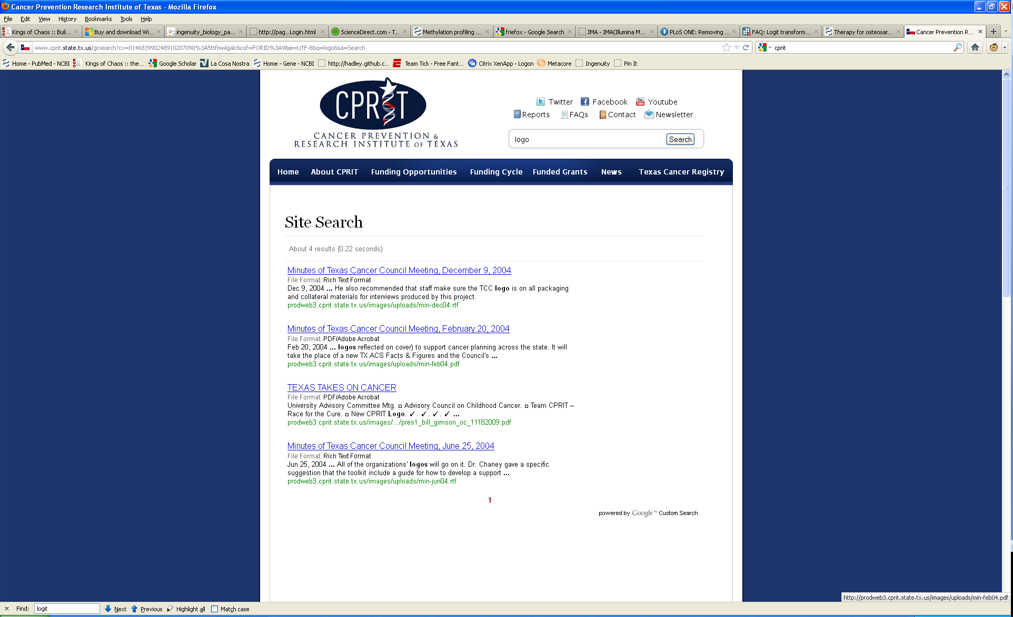
Integrated Analysis of DNA Methylation Aberrations in Osteosarcoma
Sun JM^{1,2}, Man C¹⁻³, Yu A^{2,3}, Voicu H⁵, Shen J^{2,3}, Guerra R^{1,6}, Lau CC¹⁻⁴
¹Structural and Computational Biology and Molecular Biophysics, Baylor College of Medicine, ²Cancer Genetics and Genomics Program, Texas Children's Cancer and Hematology Centers, ³Pediatrics – Hematology & Oncology, Baylor College of Medicine, ⁴Dan L. Duncan Cancer Center, Baylor College of Medicine, ⁵Genomic and RNA Profiling Core, Baylor College of Medicine,⁶Department of Statistics, Rice University, Houston, Texas
Background
Methylation Data Analysis Pipeline
Validation With RRBS
DNA methylation is an epigenetic mechanism which regulates gene transcription. In normal tissues, regions in the promoter known as CpG islands, are typically unmethylated allowing for gene transcription. Aberrant DNA methylation has been implicated in many cancers such as colorectal cancer and gliomas. In cancer, methylation of these CpG islands can result in transcriptional repression of important tumor suppressors.
Osteosarcoma is the most common primary bone cancer among children and adolescents and is characterized by a highly complex genome. While good responders to the current therapy have a favorable survival rate, poor responders and patients with metastatic disease have a much lower survival rate. Identification of these patients at an earlier time in the treatment process is vital to improving their survival rate.
To correct for technical variations in background, color-bias, batch and probe chemistries, we evaluated several pre-processing steps.
Pre-QC: removing undetected probes, checking sample integrity
Background Correction Methods:
Illumina’s GenomeStudio – subtraction of median of negative controls
Out-of-band – considers alternative color intensities Cy5/Cy3 of methylated and unmethylated beads as negative controls
Color-bias: Lumi
Infinium I, Infinium II Correction: due to the different probe chemistries as well as differences in target regions of the genome, these two assay designs give different distributions of beta-values
SWAN: corrects for differences to underlying CpG content
BMIQ: normalizes two array design beta-value distributions
sQN: subsets data and corrects based on underlying biology
Reduced Representation Bisulfite Sequencing (RRBS) is the current gold standard method for determine DNA methylation. We compared ENCODE RRBS and Methyl450K data for NHOST, an osteoblast cell line used as a normal comparison for osteosarcoma.
At the extremes, RRBS and Methyl450K agree fairly well while the middle portion of beta-values, or hemi-methylated probes are quite variant.
Beta-value of Methyl450K Data
Sample 1
Gender (Male [M], Female [F])
Fig. 2 X-chromosome methylation is gender dependent and can be an indication of a faulty or mislabeled sample.
Fig. 6 Beta-value of verlapping CpG sites between Methyl450K and RRBS data
Sample 2
Cell Line 1
Cell Line 2
Cell Line 3
Sample Information
Methylation Level of RRBS
As part of the Therapeutically Applicable Research to Generate Effective Treatments (TARGET) initiative, we have profiled the following cases on the four platforms below. Samples were collected from the Children’s Oncology Group (COG), Texas Children’s Cancer Center (TCCC) and other collaborating institutions as matched tumor and normal. All samples also have matched clinical outcome data from COG’s Statistics and Data Center. All patients in this study have been treated with the same protocol (pre-operative chemotherapy, tumor resection, post-operative therapy). All tissue DNA and RNA have passed through full pathological and molecular QC/QA evaluation.
Frequency
Raw Beta-values
GenomeStudio
Out-of-band Method
Further Analysis
In our integrated analysis with gene expression data, we identified that the most variable regions were often in the shores or shelves, regions several hundred bp upstream and downstream of the CpG island. By comparing the methylation of these regions with corresponding gene expression, we observed that the best correlated probes were also in these regions. We also evaluated a panel of genes of interest and identified that of the probes with negative correlation with expression, a majoirty of (~60%) the best correlated probes were located in the shores and shelves.
We have applied a segmentation algorithm to our data to summarize the 450,000 probes closer to a gene-based methylation value for downstream analysis in hierarchical analysis and non-negative matrix factorization as well as evaluating the relationship between miRNA and methylation.
Profiling | Platform | Samples
Copy Number | Affymetrix 6.0 SNP | 97
mRNA | Affymetrix Human Exon 1.0 ST Array | 101
microRNA | Life Technologies TLDA Card | 104
Methylation | Illumina Infinium 450K Array | 99
 | Whole Genome Sequencing
 | Whole Exome Sequencing
 | RNA Sequencing
Fig. 3 Comparison of beta-values of different background correction methods to raw data.
Beta-value
Methylation Level of RRBS
Correlation with Expression
-0.62376816
-0.305188547
-0.347304499
-0.295006278
-0.27496516
-0.191504729
-0.046950283
-0.271601115
-0.027187016
-0.270045844
-0.16407816
-0.155006428
-0.193350732
-0.227560306
-0.038588203
-0.084274322
0.015382303
-0.393752376
-0.000187383
-0.656060842
-0.418481961
Uncorrected
CpG Island
Frequency
Array Technology
Corrected
Illumina’s Infinium 450K microarray interrogates over 450,000 CpG sites at single-nucleotide resolution, covering 99% of RefSeq genes, 96% of known CpG islands and other sites specifically selected for their biological significance. The 50-bp probes on the array function through two different assay designs, Infinium I and Infinium II, giving wide coverage to both high-density and low-density regions of the genome.
Unmethylated and methylated signals are combined to calculate a beta-value, indicating the percentage of probes methylated for that CpG site.
Location Along Genome
Fig. 7 Above is the plot of the beta-value along the CpG island of a promoter region and the shores and shelves of the islands. The table to the top left is a table of correlation between methylation and expression of the probes in the plot. The table below shows the proportion of probes with negative correlation in each region near CpG islands.
CpG Island Region | Count
N. Shore | 28%
Island | 22%
S. Shore | 18%
N. Shelf | 12%
S. Shelf | 3%
Not In Island | 17%
Fig. 4 Lumi dye-bias correction on 117 TARGET samples
Unmethylated CpG Site
Methylated CpG Site
Unmethylated Bead
Methylated Bead
I
CpG Site
Bisulfite Converted DNA
Fig. 1 Infinium I design, two beads per CpG site, color not indicative of status. Infinium II design, one bead per CpG site, color indicative of status.
II
No Correction
BMIQ Correction
Fig. 5 Comparison of BMIQ and raw Infinium I and Infinium II assay probes
Acknowledgements
This research was funded by NCI grant (TARGET) CA98543-07S6, CPRIT Grant 2532328402, grants from the Gillson Longenbaugh Foundation and the Anderson Foundation, and a training fellowship from the Keck Center of the Gulf Coast Consortia, funded by the National Library of Medicine (NLM) grant T15LM007093.
Log Intensity
Infinium I
Log Intensity
Infinium I
Intensity_{Methylated}
Infinium II
Infinium II
Beta-value =
Intensity_{Methylated} + Intensity_{Unmethylated}
Beta-value
Beta-value

